Slide 1
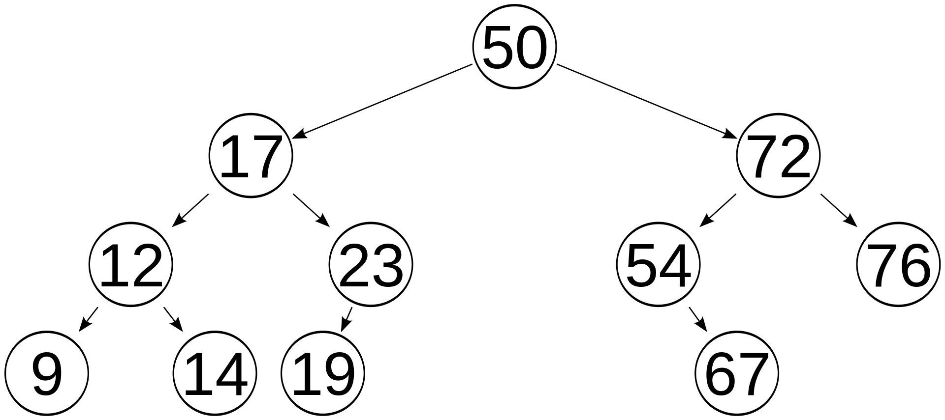
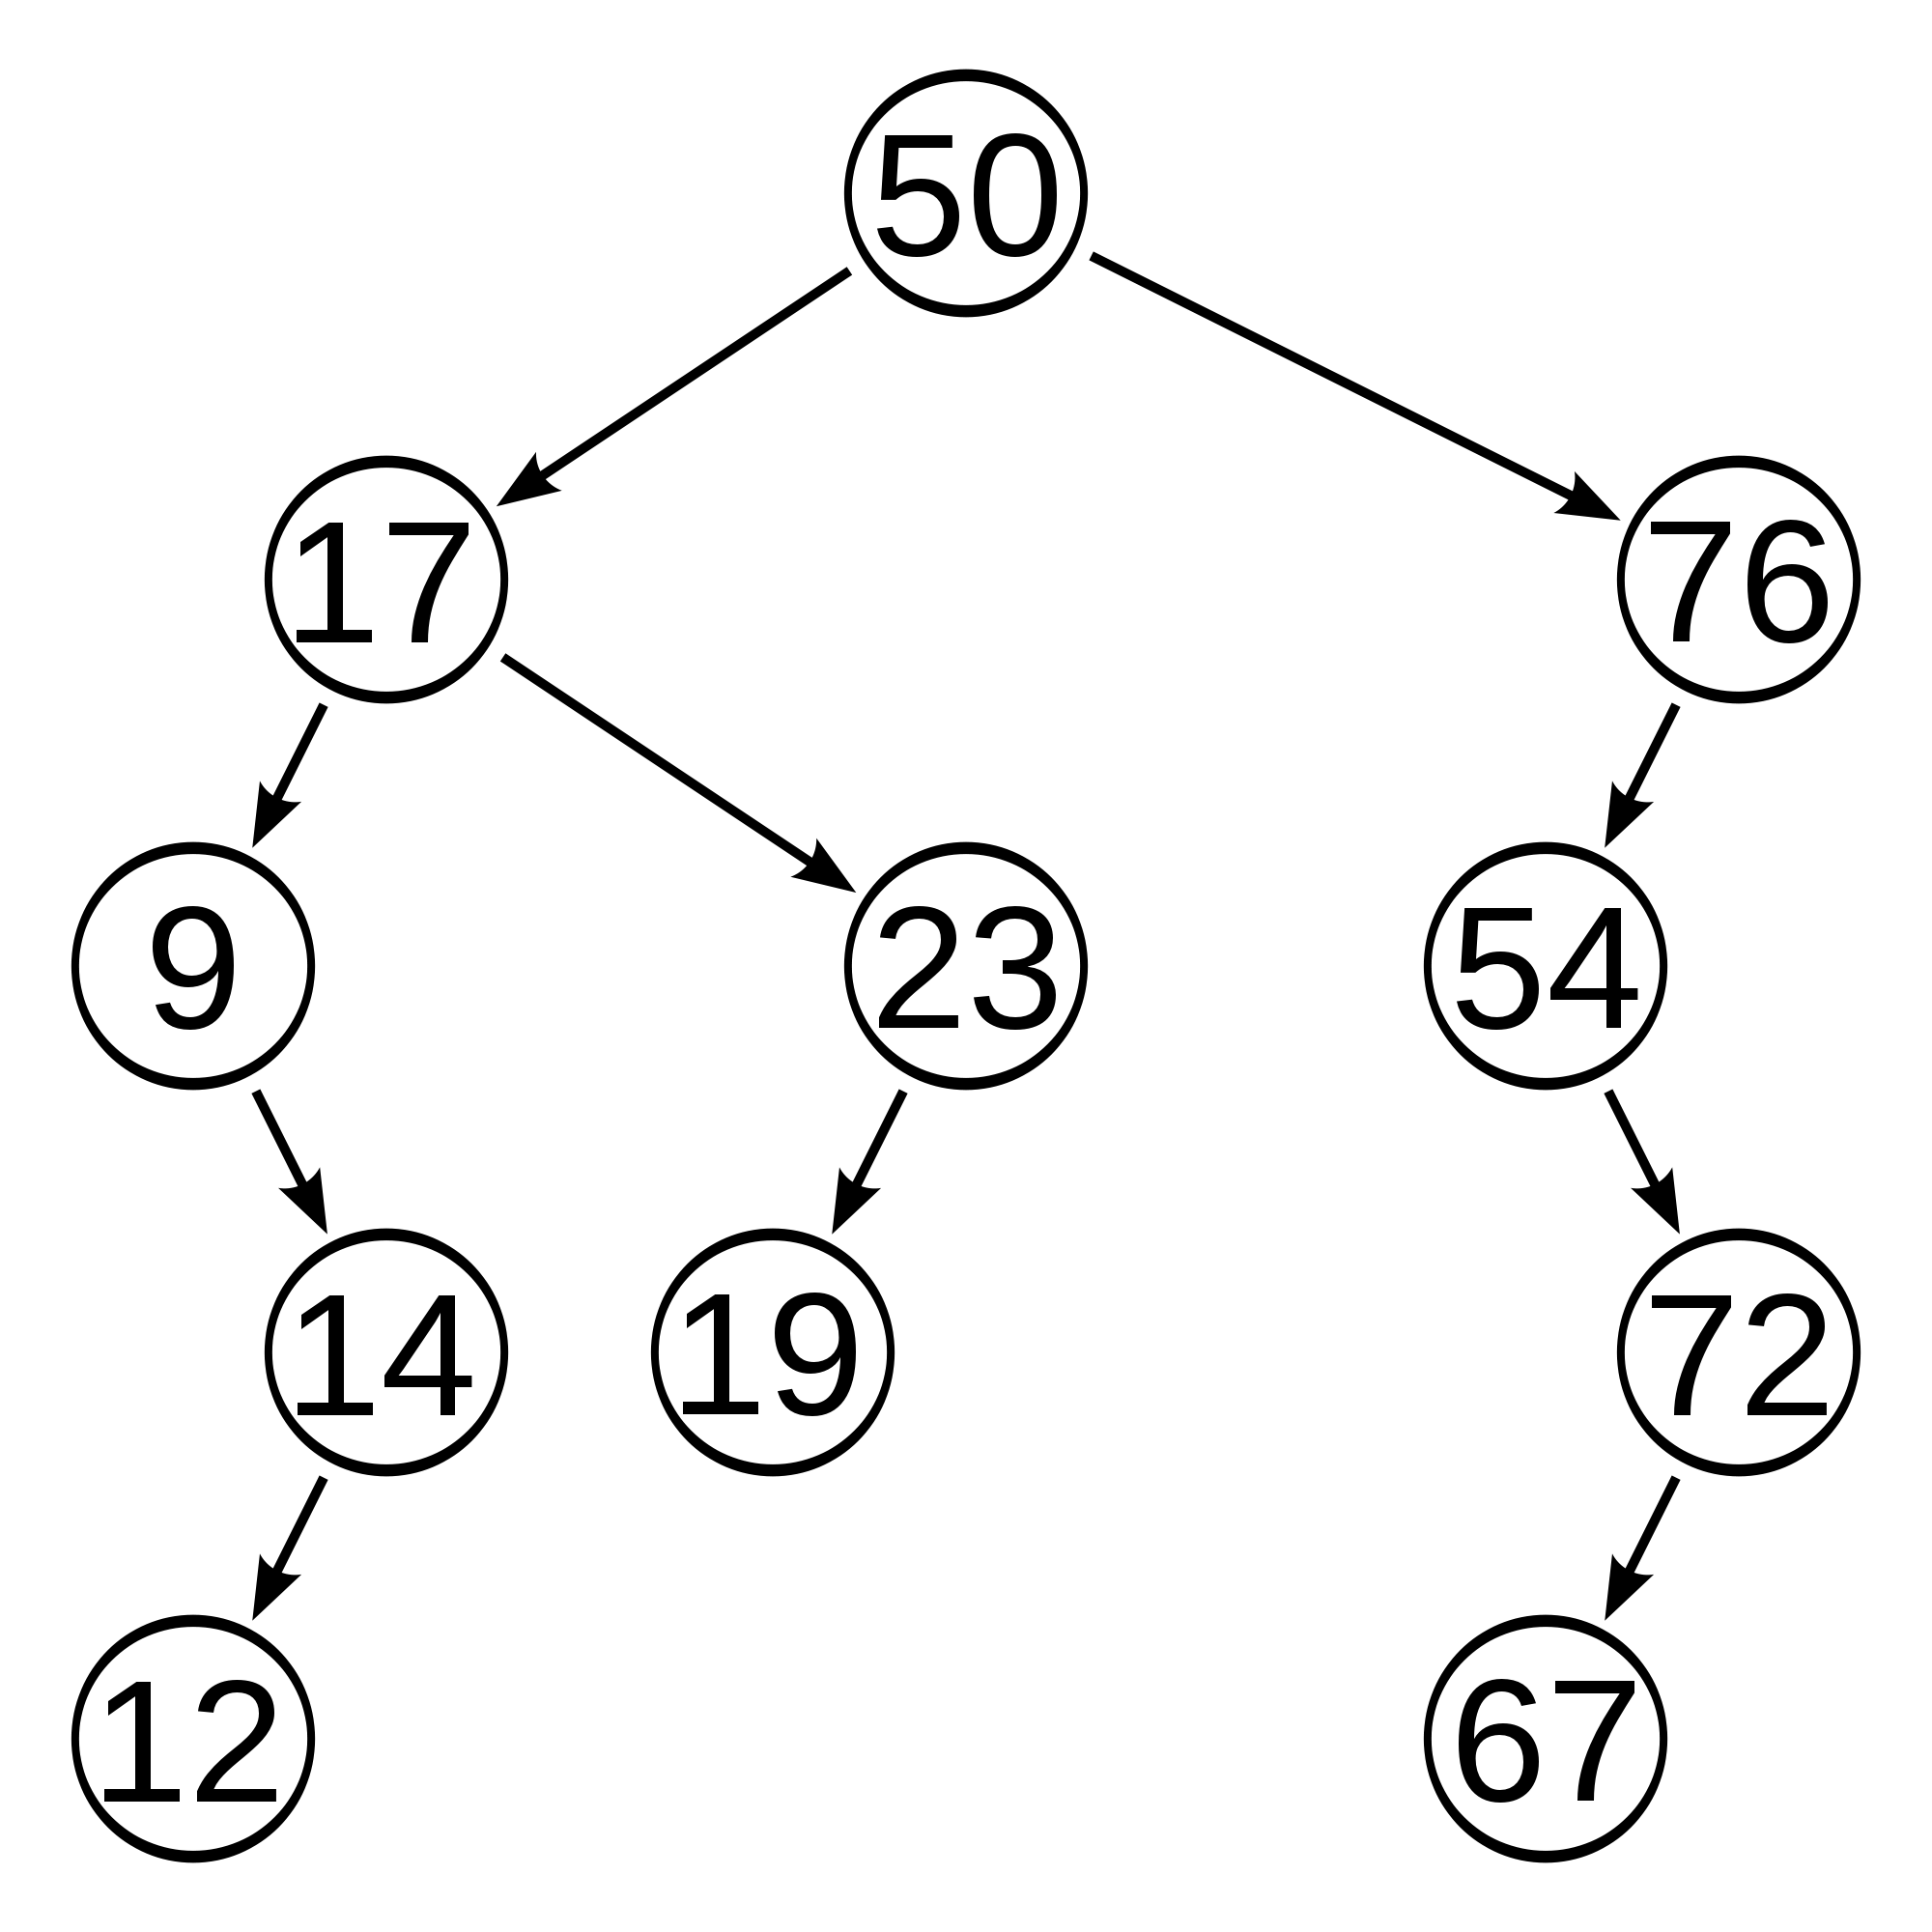
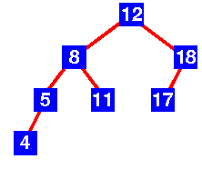
AVL Trees:
AVL Trees: Balanced binary search tree
Ensures that every node can be reached in O(log n) or less
Named after inventors: Adelson-Velskii and Landis
To stay balanced, the AVL tree maintains the following properties:
For every node, the height of the left child and the height of the right child differ by no more than 1
Every subtree is an AVL tree

Slide 2
AVL Trees:
Searching: done like a binary tree
Traversal: done like a binary tree
The sticky ones: Insertion and Deletion of nodes
At each node n, we keep track of its “balance”
n->leftchild->height - n->rightchild->height
0 (3 – 3)
0 (2 – 2)
1(2 – 1)
0 (1 – 1)
1 (1 – 0)
-1 (0 – 1)
0 (0 – 0)
0(0-0)
0 (0 – 0)
0 ( 0 – 0)
0 (0 – 0)

Slide 3
Insertion and maintaining balance:
Inserting may cause tree to become unbalanced
At least one node becomes 2 or –2
Only direct ancestors of inserted node back up to root node could have possibly changed in height
After the insert, travel up parents to the root, updating heights if necessary
If a node’s balance (h_{leftchild} – h_{rightchild}) is 2 or –2, adjust tree by rotation around the node
-1
0
2
0
1
-2
0
0
0
0
-1
68

Slide 4
Rules for insertion (this is the complicated version):
Assume we are inserting node w into a tree:
1. Perform standard BST insert with node w.
2. Starting from w, travel up ancestors and find first unbalanced node (2 or -2).
z is the unbalanced node
y is the child of z that’s on the path from w to z
x be the grandchild of z that comes on the path from w to z
3.Rebalance tree by rotating appropriately around z
There are 4 possible cases that must be handled:
1. (left-left) y is the left child of z and x is the left child of y
2. (left-right) y is left child of z and x is right child of y
3. (right) y is the right child of z and x is right child of y
4. (right-left) y is right child of z and x is left child of y
In all 4 cases, we only need to rebalance at z and the complete tree becomes balanced

Slide 5
Insertion: rotations (the fun part)
Left-left rotation:
The unbalanced node and its right child (the heavier side) both have less height on the left side
Only need to do one rotation (to the left, around the unbalanced node) if we have a left-left unbalance
-2
12
0
5
12
-1
18
3
5
7
18
3
7
15
15
inserted
Single left rotation:
5’s right child becomes 12’s left child
12’s left chld becomes 5
12 becomes new root
How many steps?

Slide 6
Insertion: rotations
Right-right rotation: pretty much the same thing
The unbalanced node and its left child are both unbalanced on the right side (have a greater left height than a right height):
Again, only one rotation needed (to the right, around the unbalanced node)
2
0
18
14
1
0
14
21
7
18
7
17
5
17
21
5
inserted
Single right rotation:
18’s left child becomes 14’s right child
14’s right child becomes 18
14 becomes new root

Slide 7
Left-Right rotation (LR)
If we have a negative balance at the root, and a positive balance at the right child
13
-2
16
2
-1
13
8
16
1
22
14
22
8
14
15
15
inserted
Simple left rotation (rotating to the left around the unbalanced node) doesn’t work :

Slide 8
Instead: Do a double-rotation
Do a right rotation on the right subtree
(even though its balance is only off by 1)
And then do our typical left rotation on the root:
-2
0
13
-2
13
14
0
-1
13
16
8
16
1
8
14
16
8
15
22
14
22
15
15
22

Slide 9
Code for rotations:
class node {
int key;
node *left;
node *right;
int height;
};
node *rightRotate(node *y){ // this is partial code – must worry about NULL children
//and about attaching rotated nodes to new parents
node *x = y->left;
node *tmp = x->right;
// Perform rotation
x->right = y;
y->left = tmp;
// Update heights
if (y->left->height > y->right->height) { //why did we look at y first?
y->height = y->left->height + 1;
}
else {
y->height =y->right->height + 1;
}
if (x->left->height > x->right->height) {
x->height = x->left->height + 1;
}
else {
x->height = x->right->height+1;
}
return x; // Return new root
}

Slide 10
Try: (You just inserted what?)
17
17
12
22
12
20
7
14
20
7
14
19
22
19

Slide 11
Try: (What did you just insert?)
20
20
20
32
7
35
7
32
7
3
26
35
3
32
48
3
26
48
34
48
26
34
51
35
51
34
51
Notes:
Stopped here

Slide 12
Pseudocode: Single Left rotation
Also check if oldroot->parent->right == oldroot,
then oldroot->parent->right = tmp
otherwise oldroot->parent->left = tmp
tmp = oldroot->right
oldroot->right = tmp->left
tmp->left = oldroot
//remember parents…
oldroot->parent = tmp
oldroot->right->parent = oldroot
12
5
12
18
3
5
7
18
3
7
15
15

Slide 13
LR (double rotation):
Remember to reset the
parents!!
tmp = root->right->left
root->right->left = tmp->right
tmp->right = root->right
root->right = tmp // not necessary, but completes first rotation
//first rotation
root->right = tmp->left
tmp->left = root;
root = tmp
5
5
7
5
12
3
12
3
7
12
3
9
18
7
18
9
9
18

Slide 14
Try: Make an AVL Tree: 17, 12, 8, 16,13,14
12
13
17
8
12
13
17
12
16
16
8
16
17
13
17
16
8
14
14
14
17
13

Slide 15
Practice:
44
44
50
17
50
44
78
17
78
48
78
17
48
62
88
32
50
88
62
88
48
62
Remove 32

Slide 16
Remove a node: (Remember?) Use BST remove
No children: delete
One child: replace with child
2 children: find the left-most descendent of the right child
And now we rebalance the tree
Starting from the deleted node, going up, rebalance the first unbalanced node

Slide 17
With Delete, we have to check nodes ABOVE for rebalancing:
50
50
25
25
75
25
60
10
50
80
10
30
55
75
5
15
30
60
10
30
60
1
27
55
75
5
15
27
55
5
15
27
1
1
Delete 80
(For height, follow path up from relocated node and recalculate height of each node (max (height of left , height of right))
stop when hit an unbalanced node, rebalance, recalculate height of that node, and then continue up path
One rotation may not be enough!
(125)

